Slide 1
Spring Boot Security

Slide 2
Spring Boot Security
Spring security is the highly customizable authentication and access-control framework. Spring Security is a framework that focuses on providing both authentication and authorization to Java applications.
“Authentication” is the process of establishing a principal is who they claim to be (a “principal” generally means a user, device or some other system which can perform an action in your application).
“Authorization” refers to the process of deciding whether a principal is allowed to perform an action within your application. To arrive at the point where an authorization decision is needed, the identity of the principal has already been established by the authentication process.

Slide 3
Spring Security Modules
Spring Security 3.0, the codebase has been sub-divided into separate jars which more clearly separate different functionality areas and third-party dependencies.
Core (spring-security-core.jar) – APIs for basic authentication and access-control related mechanism. This is mandatory for ant spring security applications.
Web (spring-security-web.jar) – APIs for servlet filters and any web based authentication like access restriction for URLs. Any web application would require this module.
Config (spring-security-config.jar) – Contains the security namespace parsing code & Java configuration code. You need it if you are using the Spring Security XML namespace for configuration. If you are not using XML configurations, you can ignore this module.

Slide 4
Spring Security Modules
LDAP (spring-security-ldap.jar)– Required if you need to use LDAP authentication or manage LDAP user entries.
ACL (spring-security-acl.jar) – Specialized domain object ACL implementation. Used to apply security to specific domain object instances within your application.
CAS (spring-security-cas.jar) – Spring Security’s CAS client integration. If you want to use Spring Security web authentication with a CAS single sign-on server.
OpenID (pring-security-openid.jar) – OpenID web authentication support. Used to authenticate users against an external OpenID server.
Test (spring-security-test.jar)– Support for testing with Spring Security.

Slide 5
Spring Security pom.xml
<dependencies>
<!-- ... other dependency elements ... --> <dependency> <groupId>org.springframework.security</groupId>
<artifactId>spring-security-web</artifactId> <version>4.0.2.RELEASE</version>
</dependency>
<dependency>
<groupId>org.springframework.security</groupId>
<artifactId>spring-security-config</artifactId> <version>4.0.2.RELEASE</version>
</dependency>
</dependencies>

Slide 6
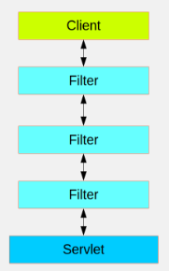
Security Filter & Filter Chains
Spring Security in the web tier (for UIs and HTTP back ends) is based on Servlet Filters. The picture below shows the typical layering of the handlers for a single HTTP request.
The client sends a request to the app, and the container decides which filters and which servlet apply to it based on the path of the request URI. At most one servlet can handle a single request, but filters form a chain, so they are ordered, and in fact a filter can veto the rest of the chain if it wants to handle the request itself. A filter can also modify the request and/or the response used in the downstream filters and servlet. The order of the filter chain is very important, and Spring Boot manages it through 2 mechanisms: one is that @Beans of type Filter can have an @Order or implement Ordered, and the other is that they can be part of a FilterRegistrationBean that itself has an order as part of its API.

Slide 7
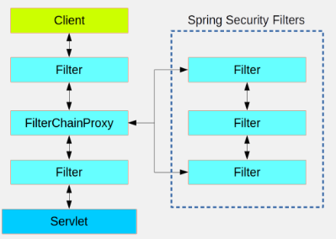
Security Filter & Filter Chains
Spring Security is installed as a single Filter in the chain, and its concerete type is FilterChainProxy, for reasons that will become apparent soon. In a Spring Boot app the security filter is a @Bean in the ApplicationContext

Slide 8
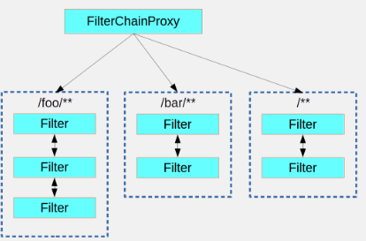
Security Filter & Filter Chains
There can be multiple filter chains all managed by Spring Security in the same top level FilterChainProxy and all unknown to the container.
The Spring Security filter contains a list of filter chains, and dispatches a request to the first chain that matches it.
The picture below shows the dispatch happening based on matching the request path (/foo/** matches before /**).
Security Adapters we implement are available here

Slide 9
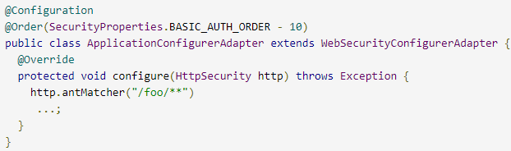
Creating & Customizing Filter Chains
The default fallback filter chain in a Spring Boot app (the one with the /** request matcher) has a predefined order of SecurityProperties.BASIC_AUTH_ORDER.
You can switch it off completely by setting security.basic.enabled=false, or you can use it as a fallback and just define other rules with a lower order.
To do that just add a @Bean of type WebSecurityConfigurerAdapter (or WebSecurityConfigurer) and decorate the class with @Order

Slide 10
How to display Filter Chain?
It is possible to retrieve FilterChain details, during program execution
Below has code snippet to display Filter Chain

Slide 11
Spring Security Basic Configuration
Basic example of a Spring Security Java configuration:
@EnableWebSecurity
public class SecurityConfig extends WebSecurityConfigurerAdapter {
@Autowired
public void configureGlobal(AuthenticationManagerBuilder auth)
throws Exception {
auth.inMemoryAuthentication() .withUser("user").password("password").roles("USER")
.and()
.withUser("admin").password("password").roles("USER", "ADMIN");
}
}
Above configuration sets up a basic in-memory authentication config.
TBD: Which all methods exist in WebSecurityConfigurerAdapter class

Slide 12
Http Basic Authentication
To enable HTTP Security in Spring, we need to extend the WebSecurityConfigurerAdapter to provide a default configuration in the configure(HttpSecurity http) method:
protected void configure(HttpSecurity http) throws Exception {
http.authorizeRequests()
.anyRequest().authenticated()
.and().httpBasic();
}
https://docs.spring.io/spring-security/site/docs/4.2.4.RELEASE/apidocs/org/springframework/security/config/annotation/web/builders/HttpSecurity.html
The above default configuration makes sure any request to the application is authenticated with form based login or HTTP basic authentication. Also, it is exactly similar to the following XML configuration:
<http>
<intercept-url pattern="/**" access="authenticated"/>
<form-login />
<http-basic />
</http>

Slide 13
HttpSecurity, WebSecurityConfigurerAdapter
Refer below URL for documentation of methods provided by HttpSecurity
https://docs.spring.io/spring-security/site/docs/4.2.4.RELEASE/apidocs/org/springframework/security/config/annotation/web/builders/HttpSecurity.html
Below is documentation of AuthenticationManagerBuilder, which is used to specify source of login credentials to verify
https://docs.spring.io/spring-security/site/docs/4.0.3.RELEASE/apidocs/index.html?org/springframework/security/config/annotation/authentication/builders/AuthenticationManagerBuilder.html
Below is documentation of WebSecurityConfigurerAdaptor
https://docs.spring.io/spring-security/site/docs/4.2.5.RELEASE/apidocs/org/springframework/security/config/annotation/web/configuration/WebSecurityConfigurerAdapter.html

Slide 14
Form Login
Spring Security generates a login page automatically, based on the features that are enabled and using standard values for the URL which processes the submitted login:
protected void configure(HttpSecurity http) throws Exception {
http.authorizeRequests()
.anyRequest().authenticated()
.and().formLogin()
.loginPage("/login").permitAll();
}
Above automatically generated login page is convenient to get up and running quickly.
usernameParameter(), passwordParameter()
TBD: How to use customized login page

Slide 15
Custom Login Form
As known in previous we refer built in login page, how ever its possible to use custom Login Form.

Slide 16
Security based on HTTP Method
Sometimes you may need to explicitly specify if specific matching rule for a certain HTTP Method. It can be done as below
http .httpBasic().and() .authorizeRequests() .antMatchers(HttpMethod.POST, "/employees").hasRole("ADMIN") .antMatchers(HttpMethod.PUT, "/employees/**").hasRole("ADMIN") .antMatchers(HttpMethod.PATCH, "/employees/**").hasRole("ADMIN");
HTTP Methods

Slide 17
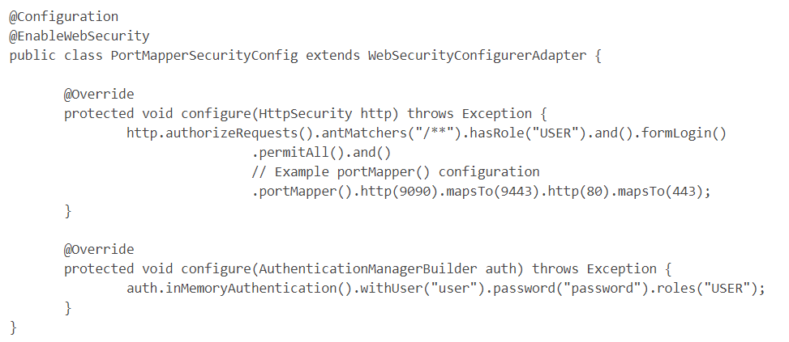
Spring Security Port Mapper
Following configuration will ensure redirects within Spring Security
from HTTP of port 9090 will redirect to HTTPS port of 9443 and
the HTTP port of 80 to the HTTPS port of 443

Slide 18
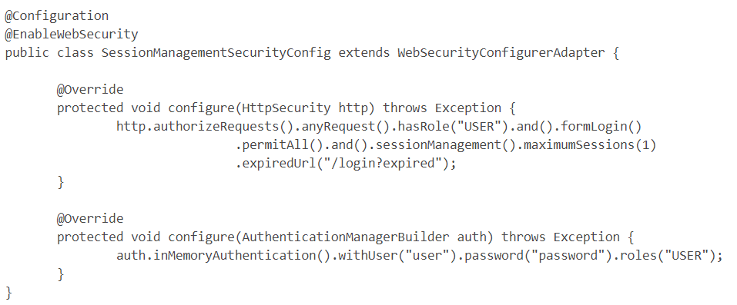
Spring Security Control Number of Logins
Following configuration demonstrates how to enforce that only a single instance of a user is authenticated at a time. If a user authenticates with the username "user" without logging out and an attempt to authenticate with "user" is made the first session will be forcibly terminated and sent to the "/login?expired" URL.

Slide 19
LDAP Authentication
LDAP authentication is one of the widely used approach in enterprise grade applications. LDAP is used as central repository for user information and applications will connect to this repository for user searches and authentication.
Pom.xml snippet
<dependency>
<groupId>org.springframework.ldap</groupId>
<artifactId>spring-ldap-core</artifactId>
</dependency>
<dependency>
<groupId>org.springframework.security</groupId>
<artifactId>spring-security-ldap</artifactId>
</dependency>

Slide 20
OAuth2 Authentication
OAuth2.0 is an open authorization protocol, which allows accessing the resources of the resource owner by enabling the client applications on HTTP services such as Facebook, GitHub, etc. It allows sharing of resources stored on one site to another site without using their credentials. It uses username and password tokens instead.
OAuth 2.0 is a simple protocol that allows to access resources of the user without sharing passwords.
It provides user agent flows for running clients application using a scripting language, such as JavaScript. Typically, a browser is a user agent.
It accesses the data using tokens instead of using their credentials and stores data in online file system of the user such as Google Docs or Dropbox account.

Slide 21
Authorization
Lets configure some simple authorization on each URL using roles:
protected void configure(HttpSecurity http) throws Exception {
http.authorizeRequests()
.antMatchers("/", "/home").access("hasRole('USER')")
.antMatchers("/admin/**").hasRole("ADMIN")
.and()
// some more method calls
.formLogin();
}
hasRole() – but also the expression based API, via access.

Slide 22
SpringSecurity features…
SpringSecurity can be used to
Allow the user to logout
Method Level Authorization
CSRF attack prevention
Session Fixation protection
Security Header integration
Password Encoding/Decoding
HTTP Strict Transport Security for secure requests
X-Content-Type-Options integration
Cache Control (can be overridden later by your application to allow caching of your static resources)
X-XSS-Protection integration
X-Frame-Options integration to help prevent Clickjacking
Integrate with the following Servlet API methods
HttpServletRequest#getRemoteUser()
HttpServletRequest.html#getUserPrincipal()
HttpServletRequest.html#isUserInRole(java.lang.String)
HttpServletRequest.html#login(java.lang.String, java.lang.String)
HttpServletRequest.html#logout()
https://docs.spring.io/spring-security/site/docs/current/reference/html/headers.html

Slide 23
Method Level Authorization
It is possible to authorize a specific method
In order to enable Spring Method level Security, we need to annotate a @Configuration class with @EnableGlobalMethodSecurity
@PreAuthorize / @PostAuthorize
Spring’s @PreAuthorize/@PostAuthorize annotations are preferred way for applying method-level security, and supports Spring Expression Language, and provide expression-based access control.
@PreAuthorize is suitable for verifying authorization before entering into method. @PreAuthorize can take into account, the roles/permissions of logged-in User, argument passed to the method etc.
@PostAuthorize , not often used, it checks for authorization after method have been executed, so it is suitable for verifying authorization on returned values. Spring EL provides returnObject object that can be accessed in expression language and reflects the actual object returned from method.

Slide 24
Method Level Authorization
It is possible to authorize a specific method
In order to enable Spring Method level Security, we need to annotate a @Configuration class with @EnableGlobalMethodSecurity
@Secured annotation is used to define a list of security configuration attributes for business methods. You can specify the security requirements[roles/permission etc] on a method using @Secured, and than only the user with those roles/permissions can invoke that method. If anyone tries to invoke a method and does not possess the required roles/permissions, an AccessDenied exception will be thrown.
@Secured is coming from previous versions of Spring. It has a limitation that it does not support Spring EL expressions.

Slide 25
Spring Security Expressions
Below Security expressions are used in Security Config implementations
hasRole, hasAnyRole - defining the access control or authorization to specific URLs or methods
hasAuthority, hasAnyAuthority – Authority is same as Role
hasAuthority(‘ROLE_ADMIN’) is similar to hasRole(‘ADMIN’) and ‘ROLE_‘ prefix gets added automatically
permitAll - permit(all users) access to some URL
denyAll – deny(all users) access to some URL

Slide 26
Spring Security Expressions
isAnonymous - enable all unauthorized users to access certain path
isRememberMe - give access to users that were logged in only by remember me function
isAuthenticated – need to login to access certain path
isFullyAuthenticated
principal, authentication
hasPermission
https://docs.spring.io/spring-security/site/docs/4.0.1.RELEASE/reference/htmlsingle/#el-common-built-in

Slide 27
Purpose of SecurityContext
SecurityContext stores the details of the currently authenticated user, also known as a Principle.
So, if you have to get the username or any other user details, you need to get this SecurityContext first.
The SecurityContextHolder is a helper class, which provide access to the security context.
Code Snippet below
Object principal = SecurityContextHolder.getContext().getAuthentication().getPrincipal();
if (principal instanceof UserDetails)
{
String username = ((UserDetails)principal).getUsername();
}
else
{
String username = principal.toString();
}
returns SecurityContext

Slide 28
Logout
As many other aspects of Spring Security, logout has some great defaults provided by the framework.
By default, a logout request invalidates the session, clears any authentication caches, clears the SecurityContextHolder and redirects to login page.
Here is a simple logout config:
protected void configure(HttpSecurity http) throws Exception {
http.logout();
}
However, if you want to get more control over the available handlers, here’s what a more complete implementation will look like:
protected void configure(HttpSecurity http) throws Exception {
http.logout().logoutUrl("/my/logout")
.logoutSuccessUrl("/my/index")
.logoutSuccessHandler(logoutSuccessHandler)
.invalidateHttpSession(true)
.addLogoutHandler(logoutHandler)
.deleteCookies(cookieNamesToClear)
.and()
// some other method calls
}
Handler need to be implemented

Slide 29
JDBC Authentication
To move that to JDBC, all you have to do is to define a data source within the application – and use that directly: //TBD
@Autowired
private DataSource dataSource;
@Autowired
public void configureGlobal(AuthenticationManagerBuilder auth)
throws Exception {
auth.jdbcAuthentication().dataSource(dataSource)
.withDefaultSchema()
.withUser("user").password("password").roles("USER")
.and()
.withUser("admin").password("password").roles("USER", "ADMIN");
}

Slide 30

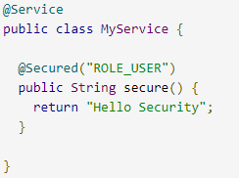
Method Level Security Control
Spring Security offers support for applying access rules to Java method executions.
The first step is to enable method security, for example in the top level configuration for our app:
Then we can decorate the method resources directly, as shown beside

Slide 31
Method Level Security Control…
How it internally work?
This sample is a service with a secure method. If Spring creates a @Bean of this type then it will be proxied and callers will have to go through a security interceptor before the method is actually executed.
If the access is denied the caller will get an AccessDeniedException instead of the actual method result.
There are other annotations that can be used on methods to enforce security constraints, notably @PreAuthorize and @PostAuthorize, which allow you to write expressions containing references to method parameters and return values respectively.

Slide 32
HTTPSecurity
A HttpSecurity is similar to Spring Security's XML <http> element in the namespace configuration. It allows configuring web based security for specific http requests. By default it will be applied to all requests, but can be restricted using requestMatcher(RequestMatcher) or other similar methods.

Slide 33
CORS
Lets configure some simple authorization on each URL using roles:
protected void configure(HttpSecurity http) throws Exception {
http.authorizeRequests()
.antMatchers("/", "/home").access("hasRole('USER')")
.antMatchers("/admin/**").hasRole("ADMIN")
Exceptions

Slide 34
How to disable Security?
Add below lines to application.properties :
security.basic.enabled=false
management.security.enabled=false

Slide 35
Spring Boot Security App
Add Spring Boot Starter Security Dependency
1. To add spring security to spring boot, first we add the dependency spring-boot-starter-security.
<dependency>
<groupId>org.springframework.boot</groupId>
<artifactId>spring-boot-starter-security</artifactId>
</dependency>
2. Extending WebSecurityConfigureAdapter
Next, create a class that extends the WebSecurityConfigureAdapter.

Slide 36
Spring Boot Security App…
3. Add the annotation @EnableWebSecurity to the class to tell spring that this class is spring security configuration.
4. Override the two overloaded methods configure(HttpSecurity) and configure(AuthenticationManagerBuilder).
The configure(HttpSecurity) defines the mapping of secured URLs or path that will determine if the user can access specific pages.
The configure(AuthenticationmanagerBuilder) determines how the security will handle the retrieval of user information commonly in the database.
Source code https://javapointers.com/wp-content/uploads/2016/08/spring-boot-security.zip

Slide 37
Spring Boot Crypto Module
Spring Security Crypto module provides support for symmetric encryption, key generation, and password encoding. The code is distributed as part of the core module but has no dependencies on any other Spring Security (or Spring) code.
https://docs.spring.io/spring-security/site/docs/3.1.x/reference/crypto.html

